Slide 1


ATLIQ GRAND HOSPITALITY ANALYSIS
A Comprehensive Review of Performance and Strategy

Slide 2

TEAM MEMEBERS
TADIMARRI SAI VARDHINI
Masthan Shaik
Pallavi Anand Nawale
Prajakta Akshay Thakre
Pooja Basaling

Slide 3

Agenda
Overview of Atliq Grand Hospitality
Key Performance Metrics
Strategic Recommendations
Conclusion

Slide 4

Company Overview
Atliq Grand:
A prominent player in India's hospitality sector, faced challenges in the luxury business hotel segment.
Premium hospitality services.
Focused on luxury and customer-centric experiences.
This project addresses those challenges by incorporating data-driven strategies and business intelligence.

Slide 5
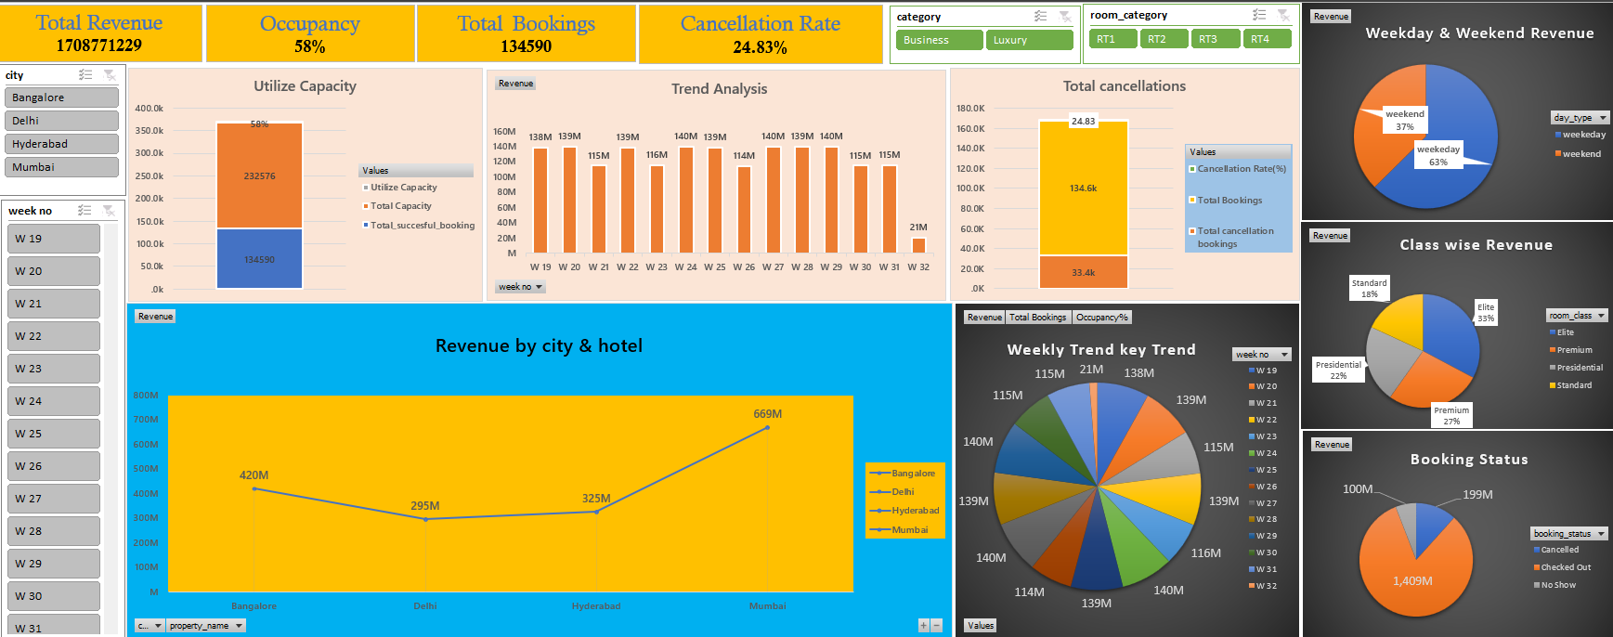
EXCEL DASHBOARD

Slide 6
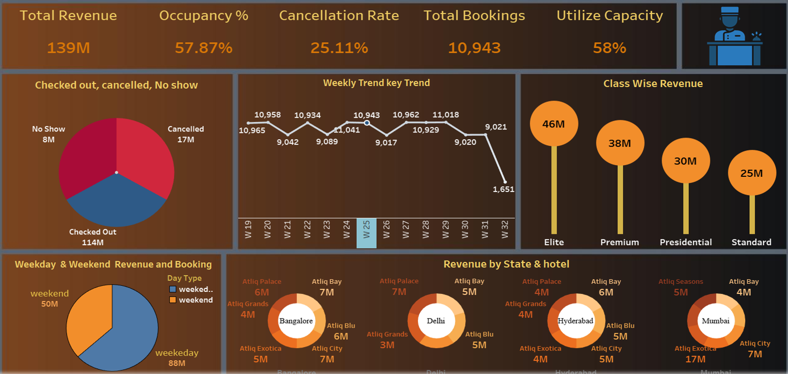
TABLEAU DASHBOARD

Slide 7
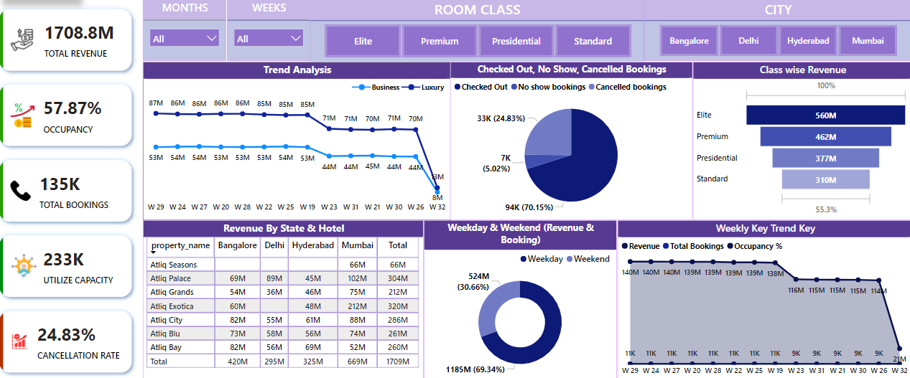
POWER BI DASHBOARD

Slide 8
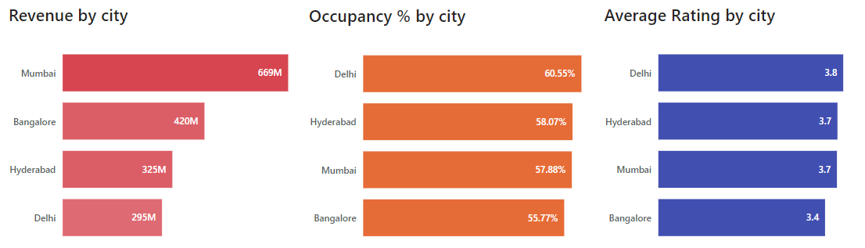
CITY WISE RANKING
1. Mumbai leads in revenue generation at 669M(39.13%), followed by Bangalore(24.6%), Hyderabad(19.03%), and Delhi(17.23%)
2. Delhi emerges as the top-performing city in both occupancy % and Average Rating.
3. Following closely behind is Hyderabad, Mumbai and Bangalore also demonstrate strong performance.

Slide 9
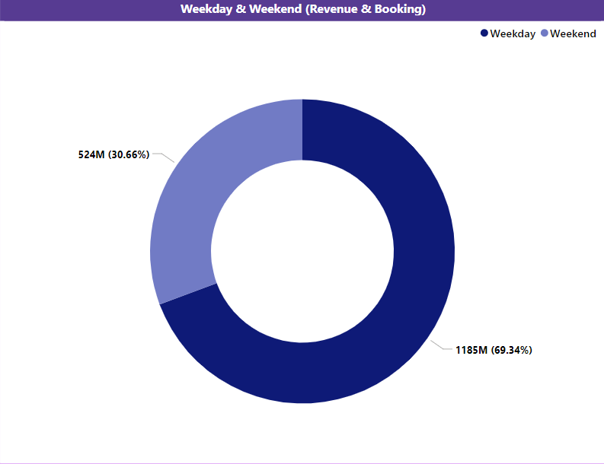
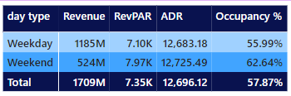
Weekends & Weekdays Revenue
During weekdays, the revenue totals 1185M, representing 69.34% of the total revenue.
Occupancy stands at 55.99%, with an Average Daily Rate(ADR) of 12.683.18 and RevPar of 7.10K.
During weekends, the revenue totals 524M, representing 30.66% of the total revenue.
Occupancy increases to 62.64%, with slightly higher ADR of 12.725.49 and an improved Revenue per Available Room of 7.97K.

Slide 10

STRATEGIC RECOMMENDATIONS
Enhance Digital Presence:
Invest in AI-driven customer service tools
Strengthen social media marketing
2. Expand Market Reach:
Target emerging markets
Develop partnerships with travel agencies
3. Focus on Customer Experience:
Personalize guest services
Regularly train staff for quality improvement

Slide 11

CONCLUSION
Atliq Grand is well-positioned in the luxury hospitality market.
Key areas for growth include digital innovation, cost optimization, and market expansion.
Emphasizing customer experience is crucial to maintaining a competitive edge.
Industry trends highlight the importance of sustainable practices and technological advancements.

Slide 12


